Slide 1
SolarCode

Slide 2


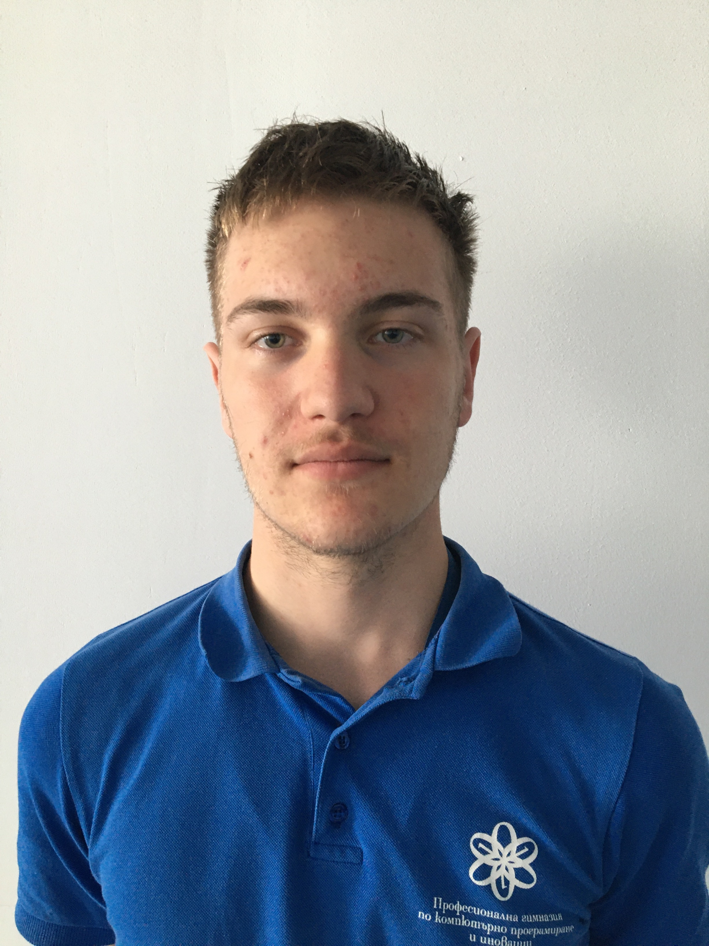
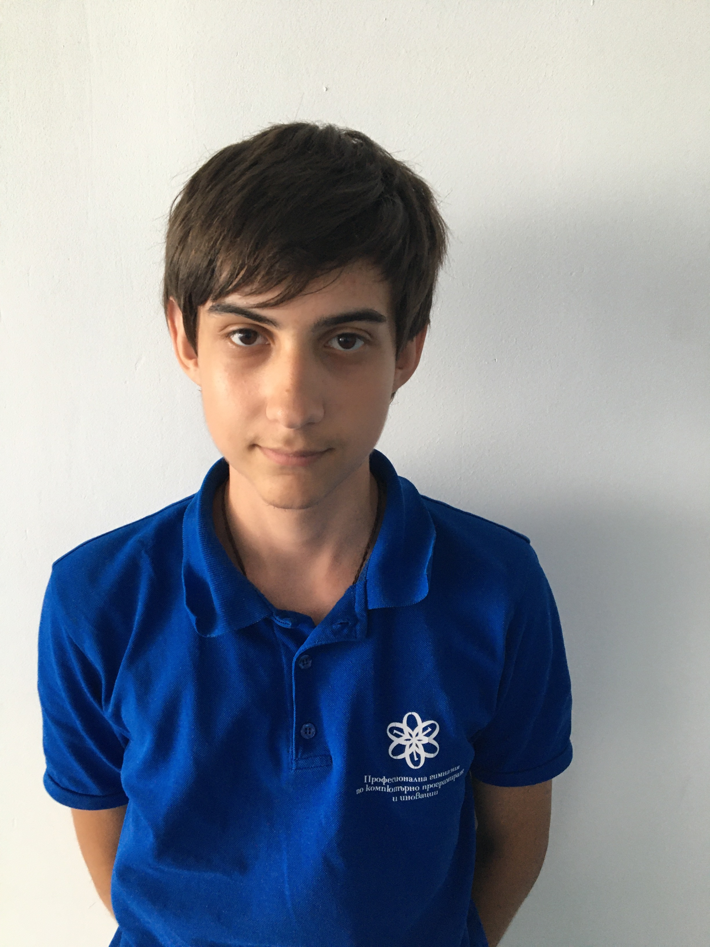
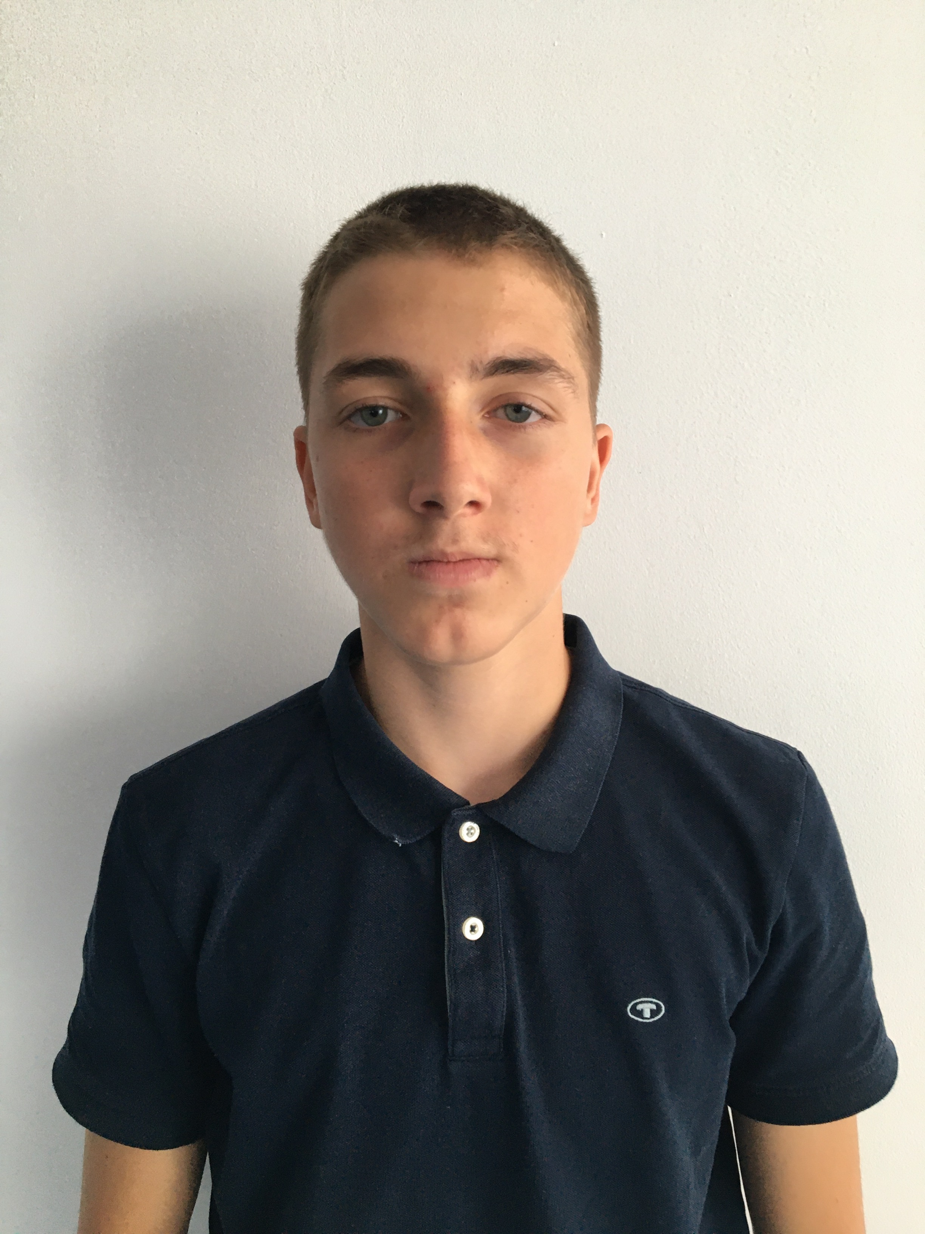
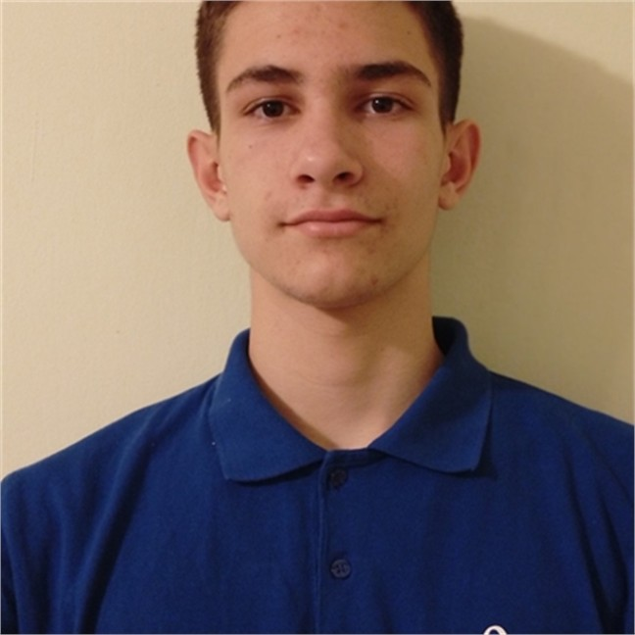
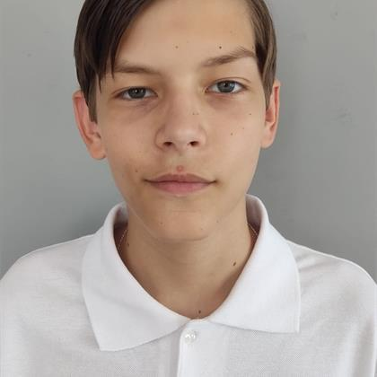
Team Members

Slide 3
The process
01
02
Have a meeting
Write the code
03
Test all the functions
04
Present

Slide 4

Our Idea

Slide 5









Used technologies

Slide 6
Let’s jump into the project!

